Slide 1
Introduction to Literature Reviews
Vicky Nembaware
vnembaware@gmail.com

Slide 2
Outline of Session
Part 1: Introduction to Literature Reviews
Publications
Different types of reviews
PICO Framework
Where could tools be used?
Part 2: Introduction to different types of study designs
Part 3: Overview of the Training
Notes:
Over 80 people on the emailing list. The planning team is on this slide..

Slide 3
What is an Academic Publication?
Academic Publication = A formal report that is published in a transparent forum such as an academic journal.
Academic publications include:
•enough detail for an independent researcher to replicate the work
•novel
•peer-reviewed
Notes:
Over 80 people on the emailing list. The planning team is on this slide..

Slide 4
Why Publish
•Communication of scientific findings
•Permanent historical records
•Key to the empirical research cycle
•Community based integrity of the publication system
•Career and graduations
•Measurable outcome/criteria used to rate scientists
Notes:
Over 80 people on the emailing list. The planning team is on this slide..

Slide 5
Types of Academic Publications
•Review articles
•Research articles
•Letters
•Research notes
•Supplemental articles
•Thesis
•Data/Database articles
•Videos (https://www.jove.com/)

Slide 6
Anatomy of a Publication: IMRaDScheme
IMRaD (Introduction, Methods, Results and Discussion)
recommended by the International Committee of Medical Journal Editors.

Slide 7
What is a Literature Review
Critical, analytical summary and synthesis of current knowledge of a topic/area
Focus/theme to organize the review (guided by a research question)
Could be exhaustive OR only cover significant, academic literature/ resources
Notes:
Over 80 people on the emailing list. The planning team is on this slide..

Slide 8
Characteristics of a Literature Review
Thematic Organization
To examine
contrasting perspectives,
theoretical approaches
methodologies
findings
Analyze previous research and point out
Strengths
Weaknesses
Any gaps
Notes:
Over 80 people on the emailing list. The planning team is on this slide..

Slide 9
What Literature can be reviewed ?
These may include:
Academic
Scholarly journal articles
Books
Conference
Proceedings
Dissertations
Patents, policies
Standards Technical Reports
Websites and other Internet Resources
Notes:
Over 80 people on the emailing list. The planning team is on this slide..

Slide 10
Where can I search for literature: Databases
PubMed
SCOPUS
CINAHL
PsycINFO
EBSCO Host
Google Scholar
Notes:
Over 80 people on the emailing list. The planning team is on this slide..

Slide 11
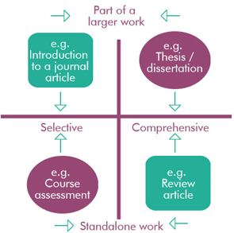
Types of Literature Reviews
Notes:
Over 80 people on the emailing list. The planning team is on this slide..

Slide 12
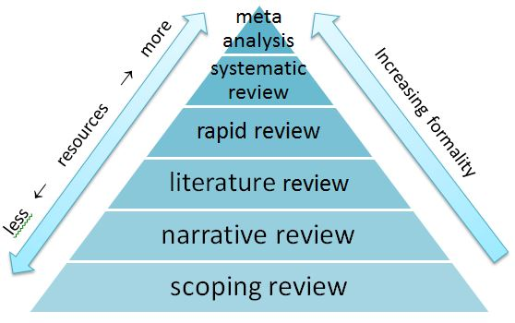
Types of Literature Reviews
https://onlinelibrary.wiley.com/doi/pdfdirect/10.1111/j.1471-1842.2009.00848.x
Notes:
Over 80 people on the emailing list. The planning team is on this slide..

Slide 13
Types of Literature Reviews
REVIEW TYPES | DESCRIPTION | APPROXIMATE TIMEFRAME | NO. OF REVIEWERS
Systematic review | Seeks to systematically search for, appraise and synthesise research evidence in order to aid decision-making and determine best practice. Systematic reviews can vary in their approach and are often specific to the type of study: studies of effectiveness, qualitative research, economic evaluation, prevalence, aetiology or risk, diagnostic test accuracy and so on. | 1 month – 2 years | 2 or more
Scoping review | Assesses the potential scope of the research literature on a particular topic. Helps determine gaps in the research. | 2-8 weeks | 1-2 or more
Traditional (narrative/expert) literature review | A generic review which identifies and reviews published literature on a topic, which may be broad. Typically employs a narrative approach to reporting the review findings. Can include a wide range of related subjects. | 1-4 weeks | 1 or 2
Notes:
Over 80 people on the emailing list. The planning team is on this slide..

Slide 14
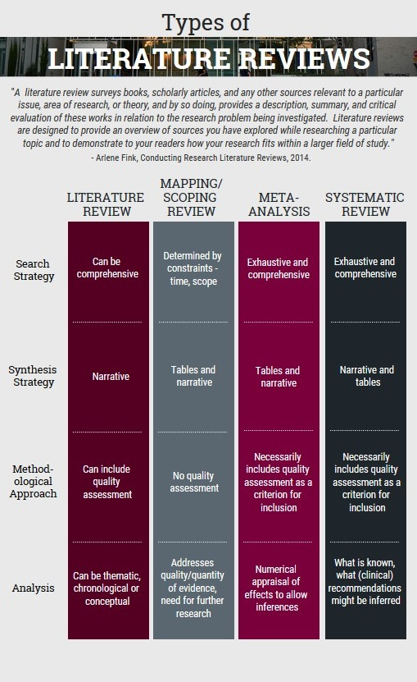
Types of Literature Reviews
Notes:
Over 80 people on the emailing list. The planning team is on this slide..

Slide 15
Systematic Reviews: Evidence- Based Areas
Cost effectiveness
Diagnostic
Epidemiologic
Individual patient data (IPD) meta-analysis
Intervention Meta-analysis
Methodology
Narrative synthesis
Network meta-analysis
Pre-clinical
Prevention
Prognostic
Notes:
Over 80 people on the emailing list. The planning team is on this slide..

Slide 16
Development of Systematic Reviews
Notes:
Over 80 people on the emailing list. The planning team is on this slide..

Slide 17
Research Question Refinement: PICO Framework
Population (P) – What individual or group are we interested in studying?
Intervention (I) – What is the action (intervention, treatment) we are
considering taking?
Comparison (C) – To what other action (intervention, treatment) are we
comparing the considered action?
Outcome (O) – What do we anticipate as an outcome?
https://www.mdpi.com/2304-6775/10/3/21
Notes:
Over 80 people on the emailing list. The planning team is on this slide..

Slide 18
Formulating A PICO question
Case Scenario:
You are a Registered Nurse working on a Urology unit. One of your patients is a 55-year-old man who is recovering from abdominal surgery – specifically a laparoscopic prostatectomy. The patient complains of abdominal pain and nausea. His abdomen is distended, and he has no bowel sounds. The registrar suspects a paralytic ileus and confirms the diagnosis based on the combination of clinical features and imaging. At the next Evidence-Based Nursing Practice Committee meeting, you discuss this case. The committee decides to do a literature review to determine if there is evidence to suggest that a simple intervention such as chewing gum post-operatively can prevent a post-operative ileus following abdominal surgery.
What could the systematic review research question be?
Notes:
Over 80 people on the emailing list. The planning team is on this slide..

Slide 19
Formulating a Question for Systematic Reviews
Based on this scenario, our research question could be:
“For patients undergoing abdominal surgery, is there evidence to suggest that chewing gum post-operatively compared with not chewing gum post-operatively affects post-operative ileus?”
Evidence Based Medicine
Notes:
Over 80 people on the emailing list. The planning team is on this slide..

Slide 20
Identifying Literature
“In patients undergoing abdominal surgery, is there evidence to suggest that chewing gum post-operatively compared with not chewing gum post-operatively affects post-operative ileus?”
PICO Elements | Keywords
Population (P) | Patients undergoing abdominal surgery
Intervention (I) | Chewing gum
Comparison (C) | Not chewing gum
Outcome (O) | Affect post-operative ileus
Notes:
Over 80 people on the emailing list. The planning team is on this slide..

Slide 21
Searching for Literature
Plan your search strategy
Plan a search strategy by:
Determining which database(s) to search
Identifying the major elements of your question
Translating natural language terms to subject descriptors, MeSH (medical subject headings), or synonyms
Synonyms, words or phrases that mean exactly or nearly the same as another word or phrase, can help expand your search appropriately. For example: when searching the keyword ‘surgery’, you might miss articles that instead describe a patient as ‘postoperative’ or in ‘recovery’. Adding synonyms will help to expand your results to those articles that are still relevant but might not include the words ‘abdominal surgery’.
Notes:
Over 80 people on the emailing list. The planning team is on this slide..

Slide 22
Searching for Literature
PICO Elements | Keywords | Search Terms | MESH Terms/Synonyms
Population (P) | Patients undergoing abdominal surgery | Abdominal Surgery | Abdominal surgery OR Surgery OR Postoperative OR Recovery
Intervention (I) | Chewing gum | Chewing gum | Chewing gum OR gum
Comparison (C) | Not chewing gum
Outcome (O) | Affect post-operative ileus | Post-operative ileus | Post-operative ileus OR Paralytic ileus OR ileus
Notes:
Over 80 people on the emailing list. The planning team is on this slide..

Slide 23
Tools
Databases (see previous slides)
Reference Managers:
e.g. Mendeley
PICO
PROSPERO
Screening Management tools: Ryyan
Quality assessment tools
Data extraction tools
Preferred Reporting Items for Systematic Reviews and Meta-Analyses (PRISMA)
Notes:
Over 80 people on the emailing list. The planning team is on this slide..

Slide 24
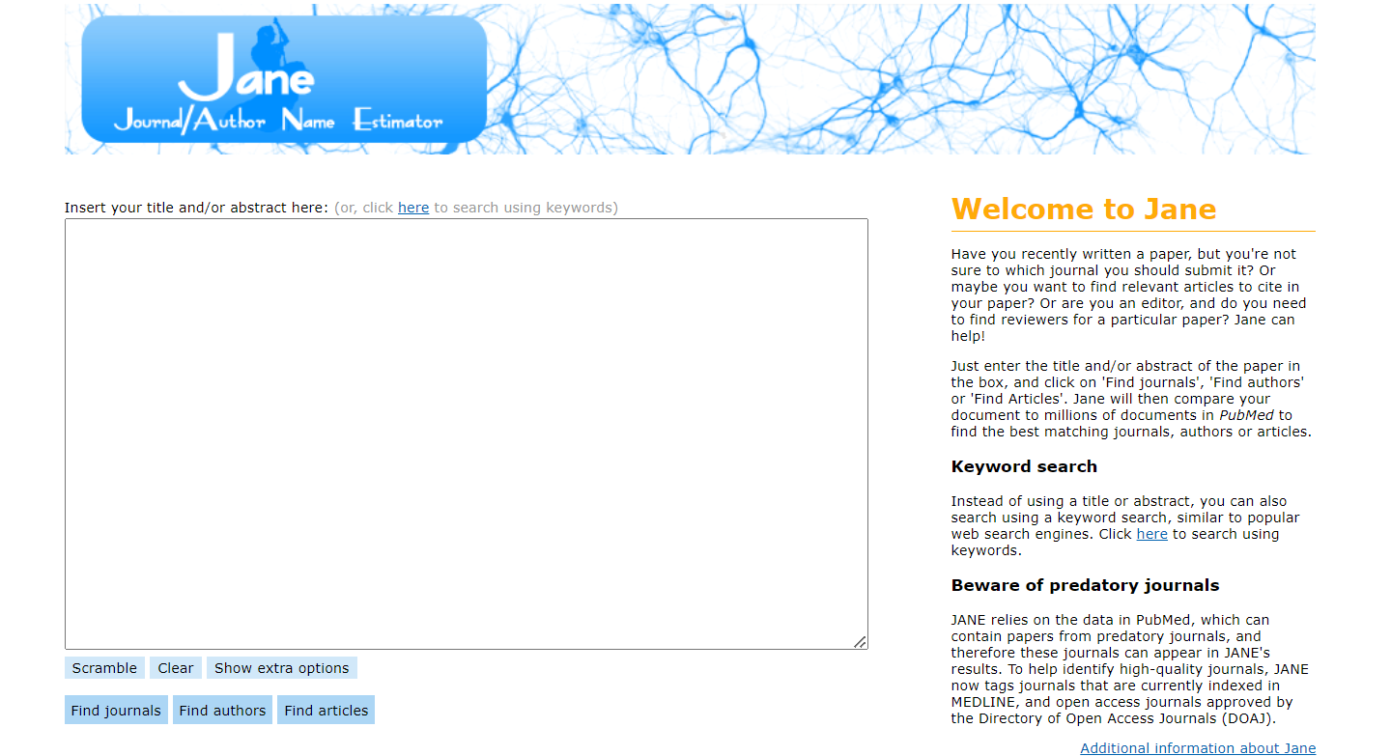
Tools
Notes:
Over 80 people on the emailing list. The planning team is on this slide..

Slide 25
Homework – Details to Follow
Discuss the systematic review protocol below:
Start PROSPERO registration
2. Google folder with details of tools and draft
https://www.ncbi.nlm.nih.gov/pmc/articles/PMC9906260/pdf/bmjopen-2022-064872.pdf
Notes:
Over 80 people on the emailing list. The planning team is on this slide..

